Slide 1
Information Visualization
By
Isaac dos Anjos
Boris Chystov

Slide 2
Information Visualization Applications
Tools and techniques for dataset comprehension
Identifying patterns for classification
Fundamental support for future decisions

Slide 3
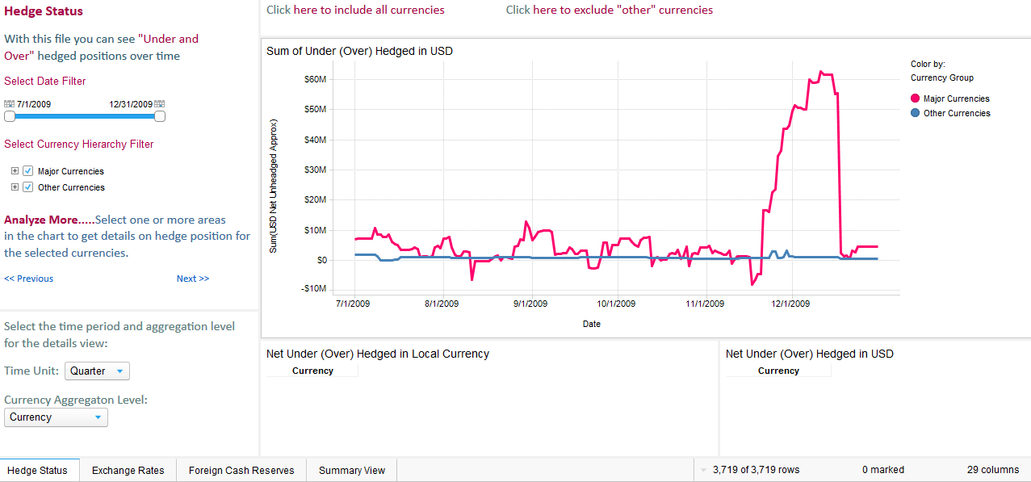
Currency Hedging Analysis
application to track and analyze currency hedging positions.

Slide 4
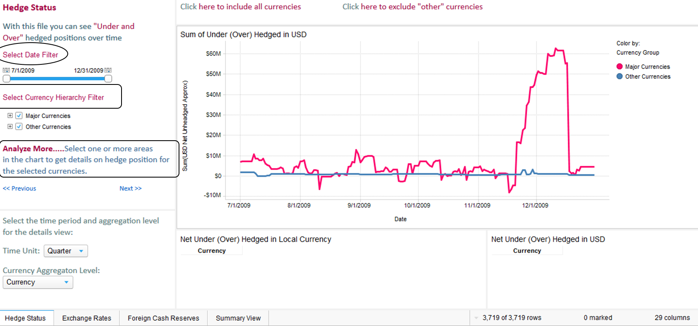
Naïve Evaluation

Slide 5
Proper way to evaluate
We used the following heuristics:
Nielsen’s heuristics - Ten Usability Heuristics for User Interface Design
Forsell & Johanson’s heuristics - Set for Evaluation in Information Visualization
Zuk & Carpendale’s heuristics - Heuristics for Information Visualization Evaluation

Slide 6
Nielsen’s Heuristics
Visibility of system status
Match between system and the real world
User control and freedom
Consistency and standards
Error prevention
Recognition rather than recall
Flexibility and efficiency of use
Aesthetic and minimalist design
Help users recognize, diagnose, and recover from errors
Help and documentation.

Slide 7
Forsell & Johanson’s heuristics
Information coding
Minimal actions
Flexibility
Orientation and help
Spatial organization
Consistency
Recognition rather than recall
Prompting
Remove the extraneous
Data set reduction

Slide 8
Zuk & Carpendale’s heuristics
Ensure visual variable has enough length
Don’t expect a reading order from color
Color perception varies with size of colored item
Local contrast affects color & gray perception
Consider people with color blindness
Preattentive benefits increase with field of view
Quantitative assessment requires position or size variation
Preserve data to graphic dimensionality
Put the most data in the least space
Remove the extraneous (ink)
Consider Gestalt Laws
Provide multiple levels of detail
Integrate text wherever relevant

Slide 9
Nielsen heuristic results
Problem | Evaluator 1 | Evaluator 2
Consistency and standards: Using the same fonts for texts and hyperlinks shows an inconsistency of standards. | 4
Match between system and the real world: “Select Data filter”, seems quite confusing. Changing it to “select a period of time” or “Select an interval”. | 2
Visibility of system status: Response time or feedback when ever the mouse hovers over a line graph is far to long. | 2
Help and documentation: I’m not familiar with all the filters, there should be a place with all of them. | 1 | 2
Recognition rather than recall: If there were flags next to each currency, quickly I can recognize each one. | 3

Slide 10
Nielsen heuristic results
Problem | Evaluator 1 | Evaluator 2
Consistency and standards: In the application, the menu bar should be at the top instead of the bottom of the page |  | 2
Aesthetic and minimalist design: The application provides too much information on opening |  | 4
Help users recognize, diagnose, and recover from errors: The application does not hold any error prevention strategies when the wants to change contexts. |  | 3

Slide 11
Forsell & Johanson’s heuristics
Problem | Evaluator 2
Recognition rather than recall: The ability to see each country’s flag beside the currency. | 3
Remove the extraneous: The grand total isn’t relevant and might distract the user. | 2

Slide 12
Zuk & Carpendale’s heuristics
Problem | Evaluator 1
Color perception varies with size of colored item: The application does contain colors which represents sizes, but unfamiliar of the scale | 1
Consider people with color blindness: The application can represent multiple countries on the platform, thus requiring multiple colors which can interfere the user’s experience if he/she is color blind | 1
Provide multiple levels of detail: The application can show data of an entire year, but when the use selects a certain day, the graph shouldn’t show 1 dot of data. If the application doesn’t have data a certain levels of details, then they shouldn’t be accessed in first place. | 3

Slide 13
Conclusion
Data presentation is important
Many techniques used to show datasets
How to properly perform analytical heuristic evaluation

